Slide 2
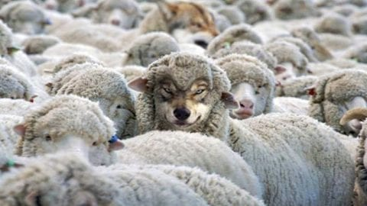
Sermon on the Mount
Matthew 5-7
“False Prophets”
Matthew 7:15-20

Slide 3
Sermon
on
the Mount
EXPECT FALSE TEACHERS
Matthew 7:15a “Beware of false prophets…”
Lit. “hold (your mind) away from false prophets”
Imposters have always been present
Jeremiah 14:14 “prophets prophesy lies”
Jeremiah 23:21,25 “I have not sent these…” “I have heard what the prophets have said who prophesy lies in My name…”
Lamentations 2:14 “false and deceptive visions”
Ezekiel 13:16 “visions of peace…when there is no peace.”
Ezekiel 22:28 “saying, ‘Thus says the Lord God,’ when the Lord had not spoken.”

Slide 4
Sermon
on
the Mount
EXPECT FALSE TEACHERS
Matthew 24:4,5 “Take heed that no one deceives you…”
Acts 5:36,37 “..Theudas rose up, claiming to be somebody… Judas of Galilee rose up..”
Motivation for such false prophets is PRIDE or SELF-INDULGENCE
EXAMINE FOR FALSE PROPHETS: (7:15-18)
They Come Like Sheep – Jude 4
They claim a noble purpose – “We know how to get the people in, put the church on the map!”

Slide 5
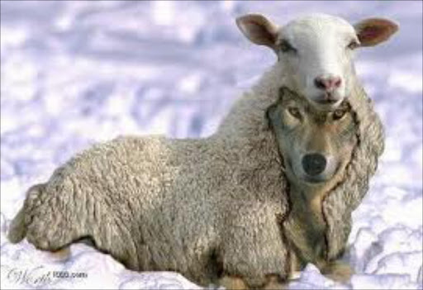
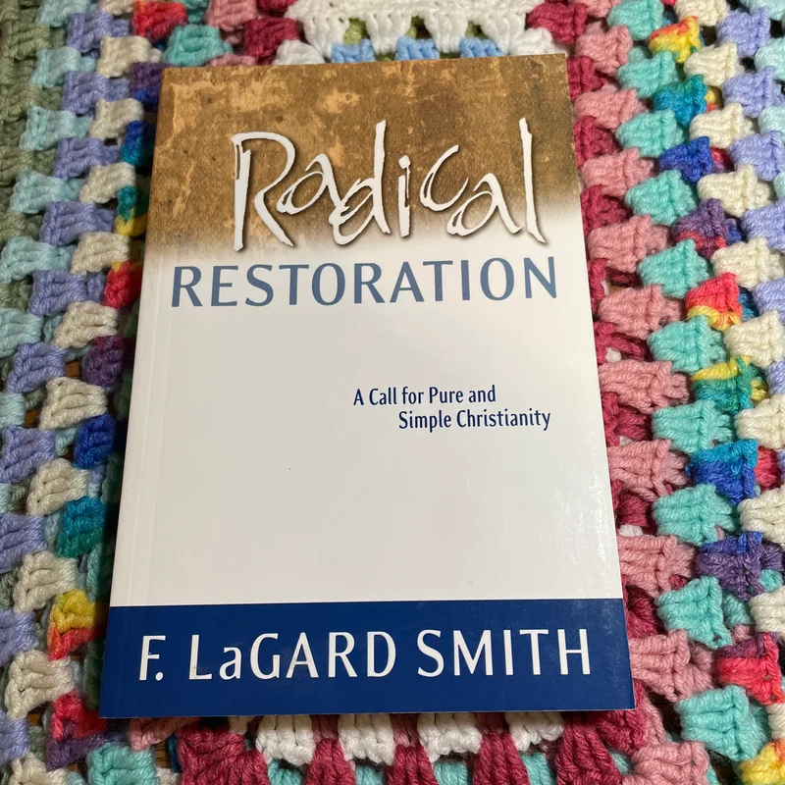
“When I was sitting where you are sitting at a junior college in Florida (Florida College GE), I had some thoughts and some ideas,… some concerns,… that I couldn’t share with a lot of people, because they were pretty unorthodox.” F. LaGard Smith

Slide 6
Sermon
on
the Mount
EXPECT FALSE TEACHERS
EXAMINE FOR FALSE PROPHETS: (7:15-18)
Look For Their Traits
Galatians 2:4 “false brethren secretly brought in…”
Pose as “true believers,” "Wolves in Sheep’s clothing.”
Romans 16:17,18 “by smooth words and flattering speech deceive the hearts of the simple.”
2 Corinthians 11:13 “false apostles, deceitful workers”

Slide 7
Sermon
on
the Mount
FRUIT IDENTIFIES TREE WHICH BEARS IT
Matthew 7:16-18 “You will know them by their fruits”
“Fruits” refers to Doctrines – what is taught
We teach by EXAMPLE and WORDS
Fruits are practical effect of teaching
When results are bad, teaching itself must be bad
1 John 4:1 “do not believe every spirit, but test the spirits, whether they are of God; because many false prophets have gone out into the world.”

Slide 8
Sermon
on
the Mount
EXPEL THEM
Matthew 7:19,20 “cut down and thrown into the fire.”
Unfruitful Tree Cut Down!
What would result if we don’t identify false teachers?
Are we wrong to cast out false teachers as soon as they are identified?
1 Corinthians 5:13 “put away from yourselves the evil person”
2 Thessalonians 3:6 “withdraw from every brother who walks disorderly…”
Are we to issue a warning? YES!

Slide 9
Sermon
on
the Mount
WE MUST “BEWARE”
Matthew 7:15a
“Heaven and hell are myths.”
“The God of love will not permit anyone to be punished everlastingly.”
“Satan is a myth.”
“Sin is sickness. Nothing to do with Guilt!”
“Individual not responsible for his own so-called sins. Blame rests on parents/society.”
“Many situations are not really sin at all…”

Slide 10
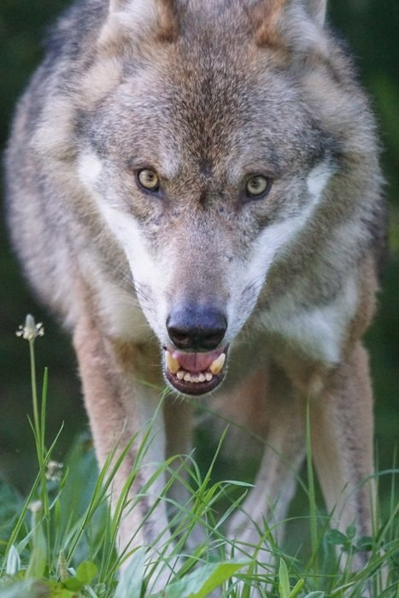
Sermon
on
the Mount
“R AVENOUS WOLVES”
“Ravenous - GREED and Cruelty – John 10:12
Luke 18:11 “extortioners”
We must be on guard against those who distort Word of God for selfish purposes
Cannot assume all love the TRUTH
Cannot assume a little error won’t hurt anything.
We must be Fearless
We must confront false teaching

Slide 11
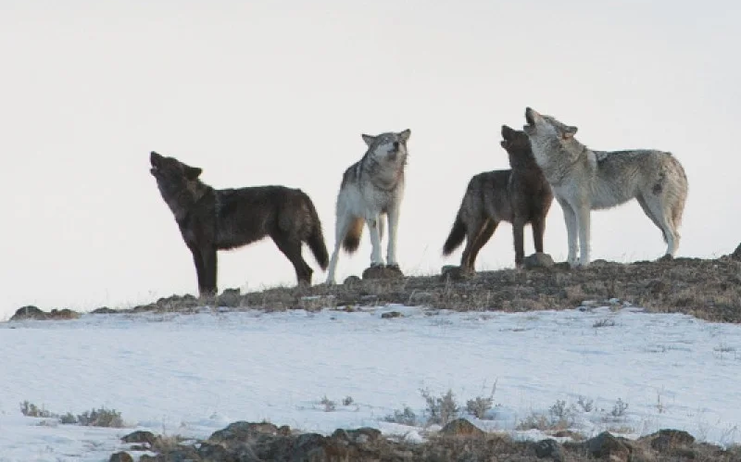
Sermon
on
the Mount
MUST “CUT DOWN” THE FALSE PROPHET
Matthew 7:19 NKJV 19 "Every tree that does not bear good fruit is cut down and thrown into the fire.”

